Slide 1
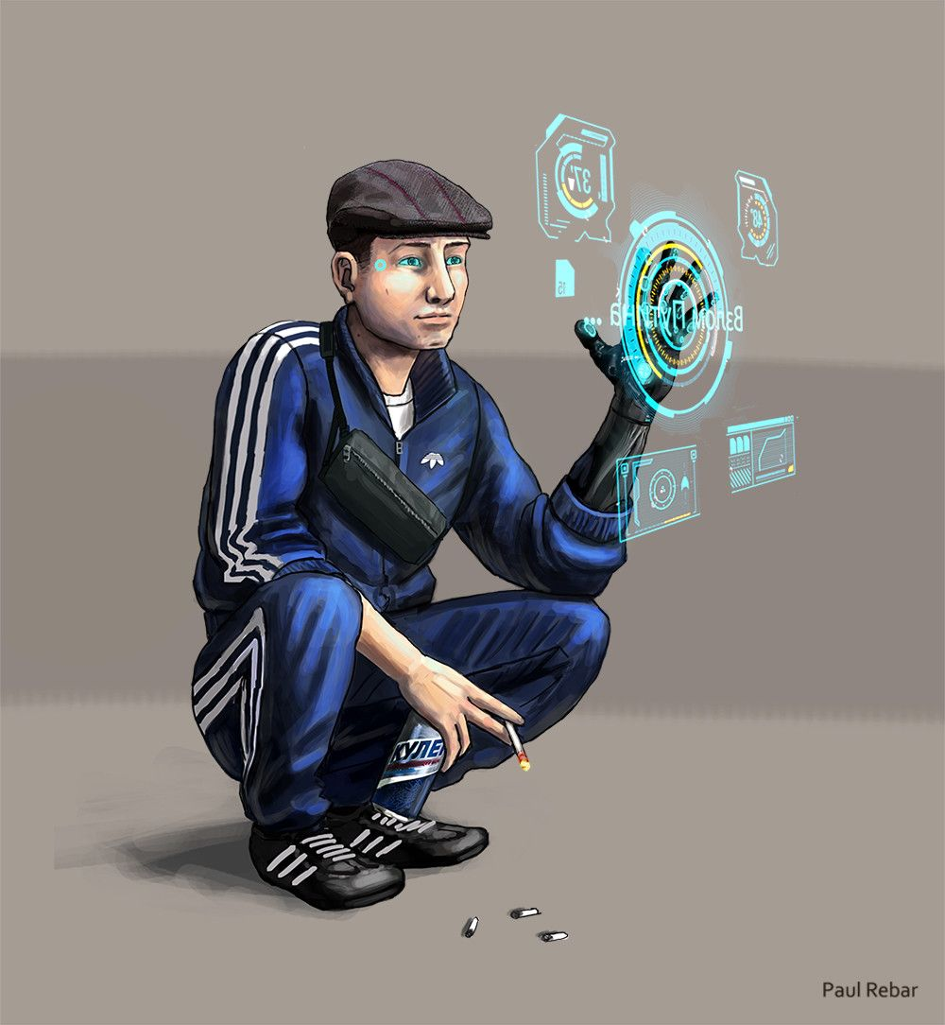
d1m1try
Pt.6

Slide 2
Disclaimer
First of all, d1m1try project does not support any actions that violate law in any means. Cracking the security of computer systems is bad and considered as a crime to gain unauthorized access to computer systems. The purpose of this educational material is building competence on how to create robust automotive products by getting hands-on experience about frequent vulnerabilities.
d1m1try Project is published under the GNU General Public License v3.0.
Credits:
Story and technical framework: János Kovács
Slide 1: All rights reserved by Paul Rebar. The publishing of his painting here happens with his explicit acceptance.
Slide 3: Eltpcs, Common Creative license: CC BY-NC 2.0
Slide 4: Skepticalview, Common Creative license: CC BY-NC-ND 2.0
Slide 5: Steve Corey, Common Creative license: CC BY-NC-ND 2.0
Slide 6: Jose Maria Perez Nunez, Common Creative License: CC BY-NC 2.0
Slide 7: DonkeyHotey, Common Creative License: CC BY 2.0
Slide 8: C.K. Hartman, Common Creative License: CC BY 2.0
Slide 9: Carl Campbell, Common Creative License: CC BY-SA 2.0
Slide 10: Adam Chandler, Common Creative License: CC BY-NC-ND 2.0
Slide 11: Grant Hutchinson, Common Creative License: CC BY-NC-ND 2.0
Slide 12: Nikola Bagarov: Common Creative License: CC BY-NC-ND 2.0

Slide 3
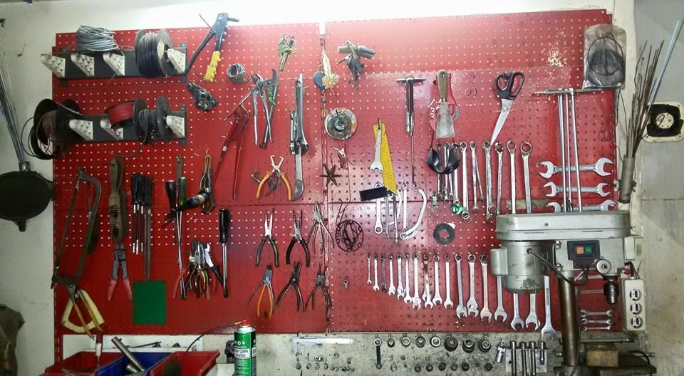
Good news
You’ve got a call from the downtown Syndicate garage that they heard about your skills at a car electrician, and you could work for them.
Since being poor and hopelessly looking for a job is not a great thing to you, you go for the interview and they hire you with enough salary to increase your quality of life a little bit and even having a backup fund for the unexpected expenses of the future.

Slide 4
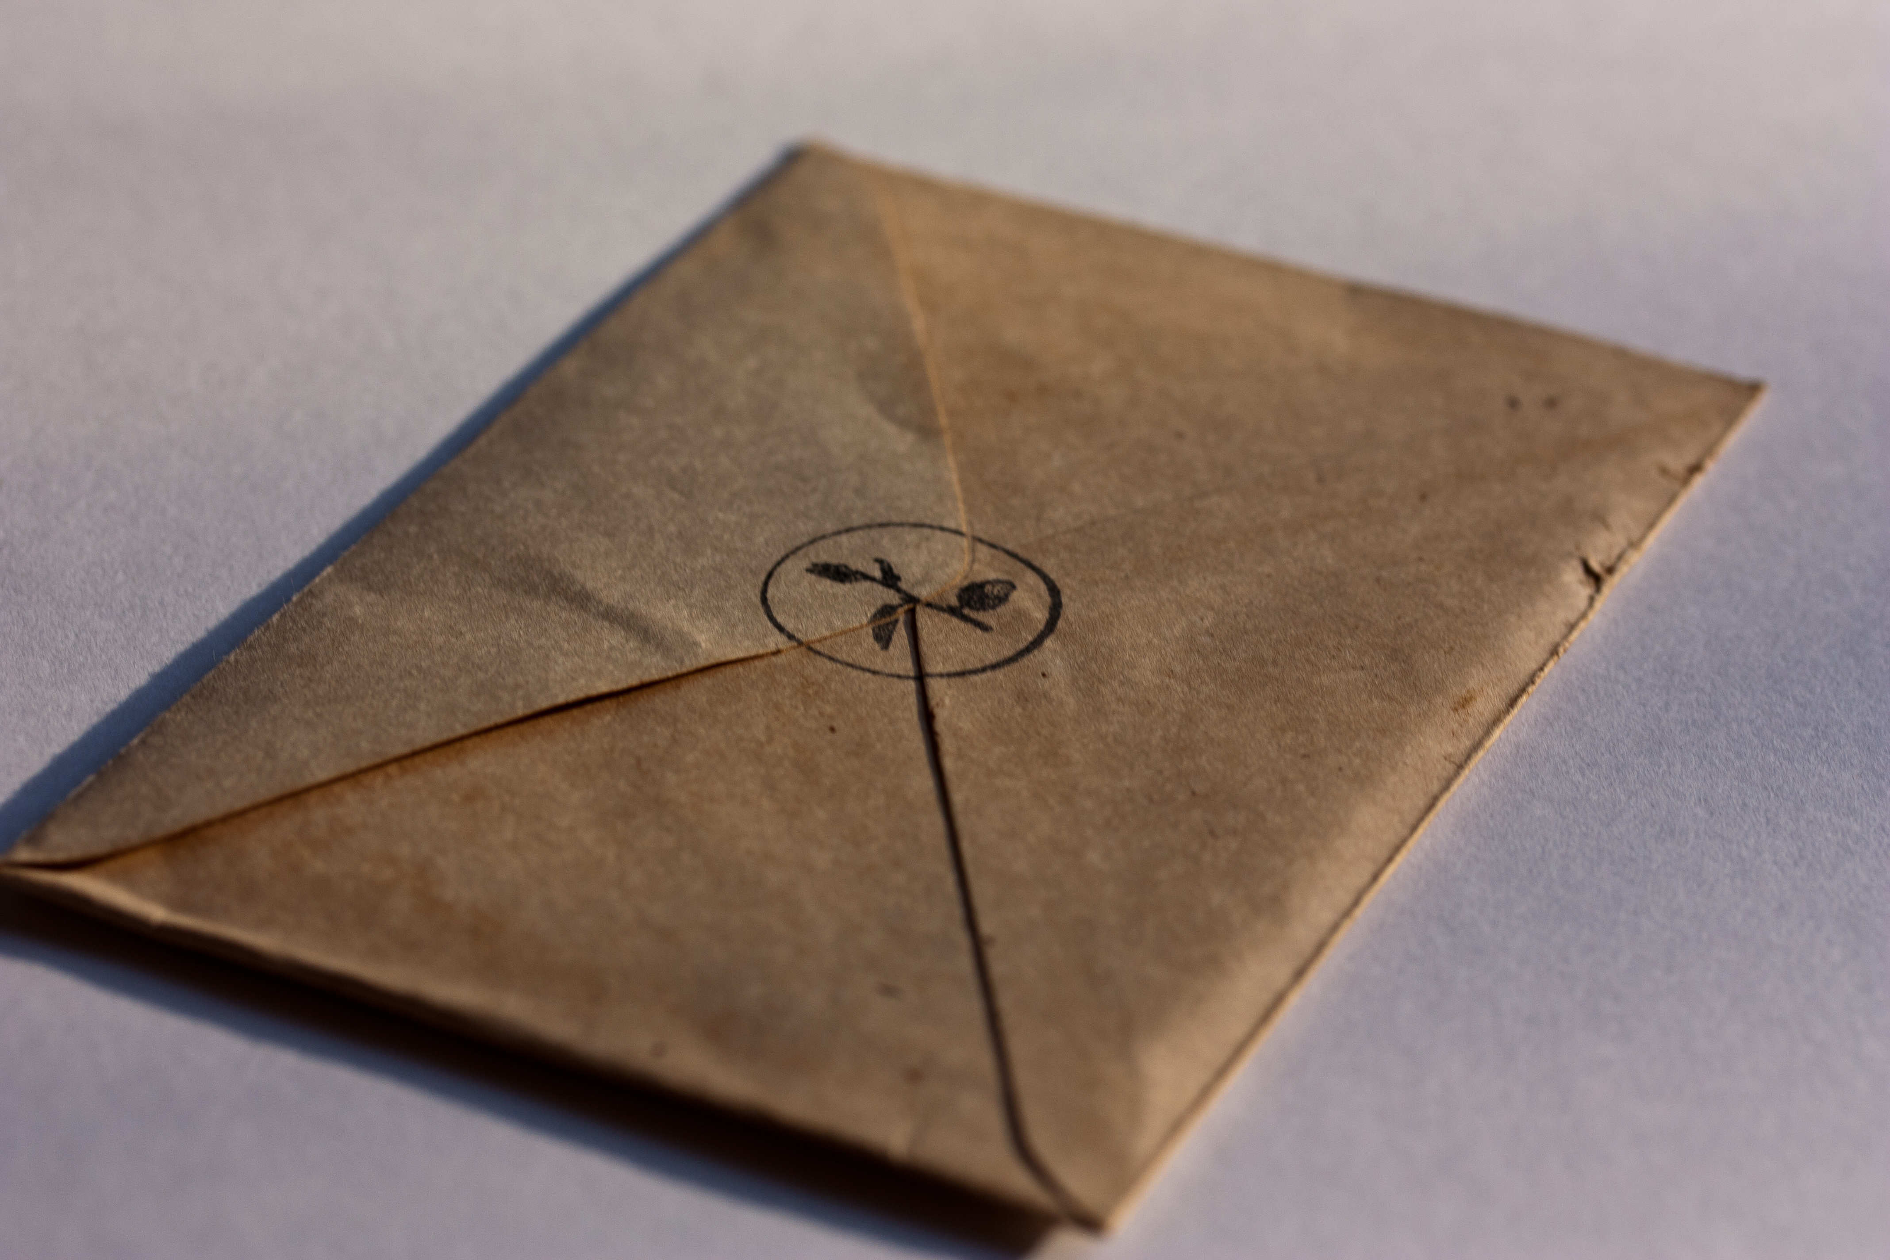
You start to think that your life will get back to the right track, but after your first day, you find an envelope in your locker. There is a message inside that:
You thought they hired you for your famous skills, right? Do not forget that you belong to us now. You helped us, we helped you. But make your staying useful, ok?
Earn some money, get your shit together, and help us in a certain matter: record valid challenge&response pairs for the body computer of a Syndicate Diplomat. This type of vehicle is secured with proper brute force protection and there is no vulnerability of the xcp either. We tried that one, and did not work, btw it was great job that you found that backdoor. Your next job will be a Diplomat, and you need to prepare. Collect the data above and you might be able to use that later in a crucial mission.

Slide 5
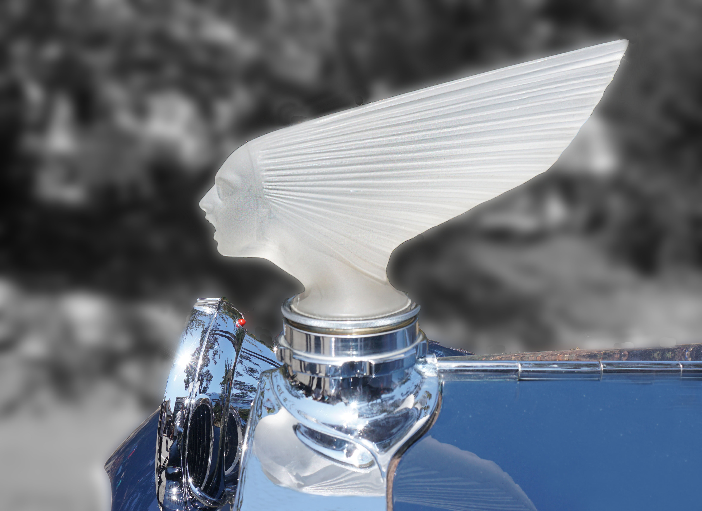
You do not need to wait a lot until some rich Siberian guy arrives with his Diplomat.
This is a high end luxury car, the flagship of Syndicate, and the billionaires of Chernograd loves it for showing off their wealth to their fellows.
You are now an agent of the Resistance. Interesting, never thought you’d end up like that. Your role here is to gather valid pairs of challenges and responses, you are sure those will be utilized in another mission.
HINT0: execute start_stage6_1.bat and record valid challenges and responses into dict.py.

Slide 6
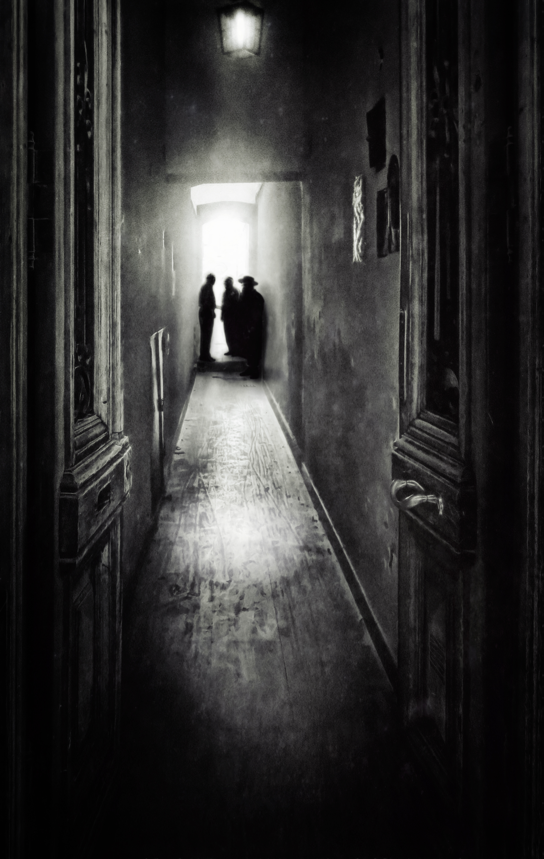
When you manage to leave the garage after this long day, with the data collected hidden under the casing of your phone, you met unexpected visitors you’ve never met on your doormat.
Two middle aged guy and a beutiful girl similar to the one from last time, probabily related to her in some family way. Regarding the fact that the corridor is full of curious people who like to report anything suspicious to the police, it is quite surprising that they do not look frustrated from the resonable chance of having visitors from the police at all. Might they have some connections at really high places, huh?
‚Hello Dimitri. It’s good to finally meet.’ – says the one with a wide hat and a long coat. He looks like the mixture of Clint Eastwood and Danny de Vito from the movies of the last century.
‚Who are you?’ – you ask.
‚Friends.’ – says the other man.
‚You helped us out a few time’ – nods the girl gracefully.
‚…get back to talk.’ – you say. You open the door and show them the way in, and you gather around the kitchen table.
Clint de Vito clears his throat.
‚We are here because we have a huge opportunity now.’ – he takes his holo-pda out from his packet and opens a picture of a politician you know really-really well.

Slide 7
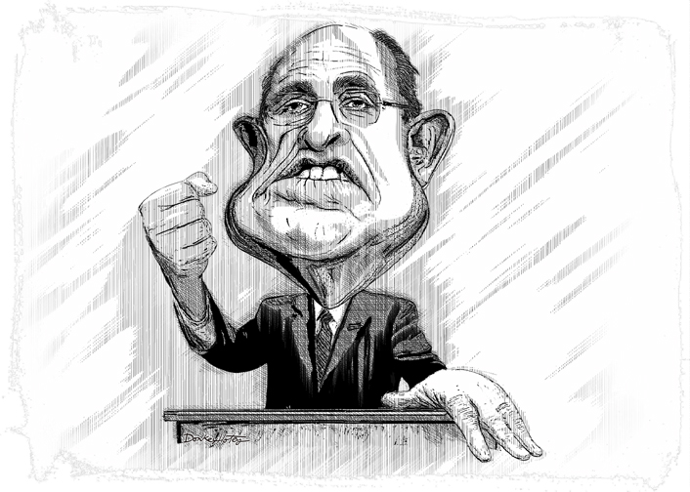
‚He is our key to defeat this system. We found some traces leading to him at the terrorist camp after taking care of those pigs. As the prominent member of the State Party, evidences about him supporting the mob will make the people rise against the oppression hopefully. We strongly beleive that his username and password might be stored at the NVM of the computer of his ride. If you could collect this, we might be able to break into his other accounts as well.’

Slide 8
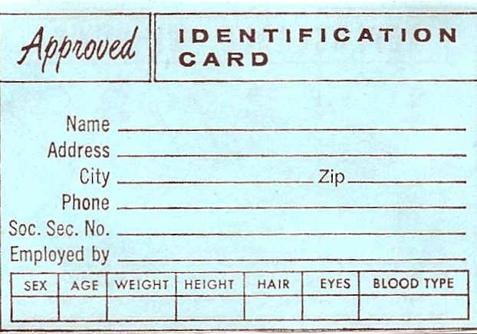
‚You will call sick to work tomorrow and we will get you inside the State Party Office as a valet, who parks the cars of the big guys. Some day, sooner or later, he will arrive with his personal Diplomat, and that will be your opportunity. You get in and park tha car properly. However, at the parking lot, you’re gonna make your move on reading out the user ID and the password from the car. As soon as it’s done, you’ve nothing else to do and the people of Chernograd won’t be graceless for your service. And don’t worry, the Syndicate garage will tolerate your absence as long as it’s required, we’ve ways to take care of that.’
The girl adds:
‚Use the data you collected to get access to the credentials. I spotted that the system does not limit the seed requests at all.’ – she hand over a micro-PDA to you - If you upload the recorded challenge response pairs and execute this script I wrote, you might be able to get the access rights you need.’

Slide 9
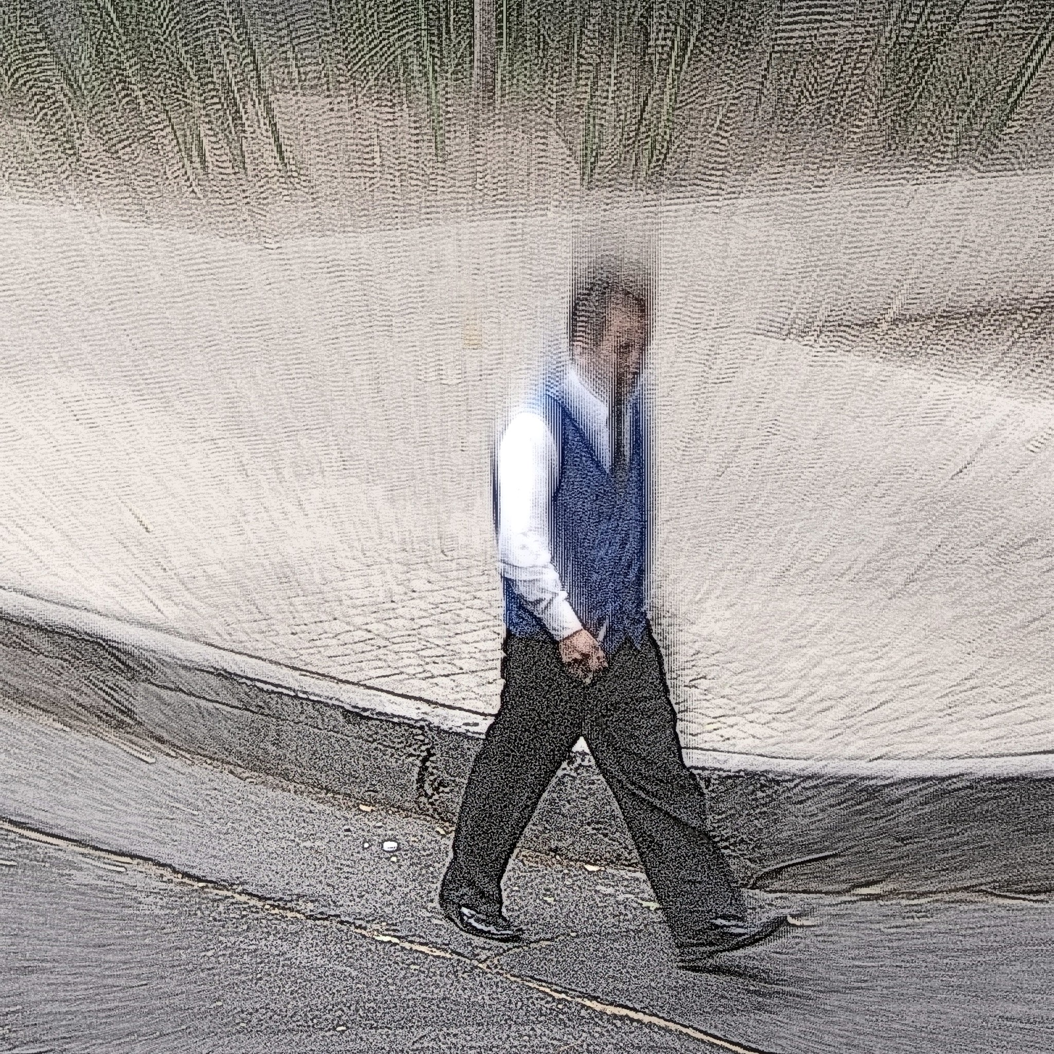
You do what they said even with hope that you will contribute in the removal of the corrupt government (or is that Stockholm syndome?).
One day, a shiny Syndicate Diplomat shows up in front of the office, and the person of interest throws you the keys without any word while hurrying up the stairs.
You get in, with your blood pressure at the sky, and park the car seamlessly to a vacancy at the back of the parking lot.
TASK: Extract the user ID and the password from the vehicle computer’s NVM.
HINT0_1: Execute run_stage6_2.bat to see whether you can do anything to succeed with the mission.
HINT0_2: Execute the script the unknown girl gave to you.

Slide 10
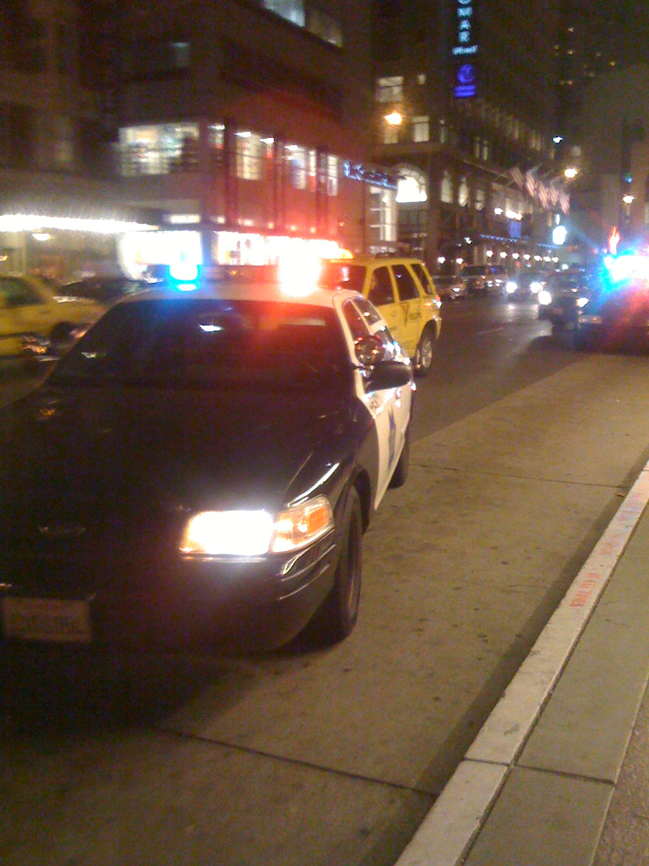
When you got to the building where your apartment is, you see that there is an ongoing police raid there.
A car pulls the brake near you. It’s the girl who pushed a gun in your face.
‚Get in.’ – she says.
You obey, since you know clearly who might the policemen look for.
She hand over a black linen bag. – ‚Put this on. We cannot risk that our hiding place will be disclosed.’
It seems a reasonable argument, so you – again – do what she said. After a long drive, you feel that the car stops.
‚You can pull that down now.’ – she says, now more softly. You are in a garage with a lot of people, distributing guns and ammo in wooden crates.
She leads you to a room full of excited people, and you recognize among them Danny Eastwood and the other, tall guy who paid you a visit last time.

Slide 11
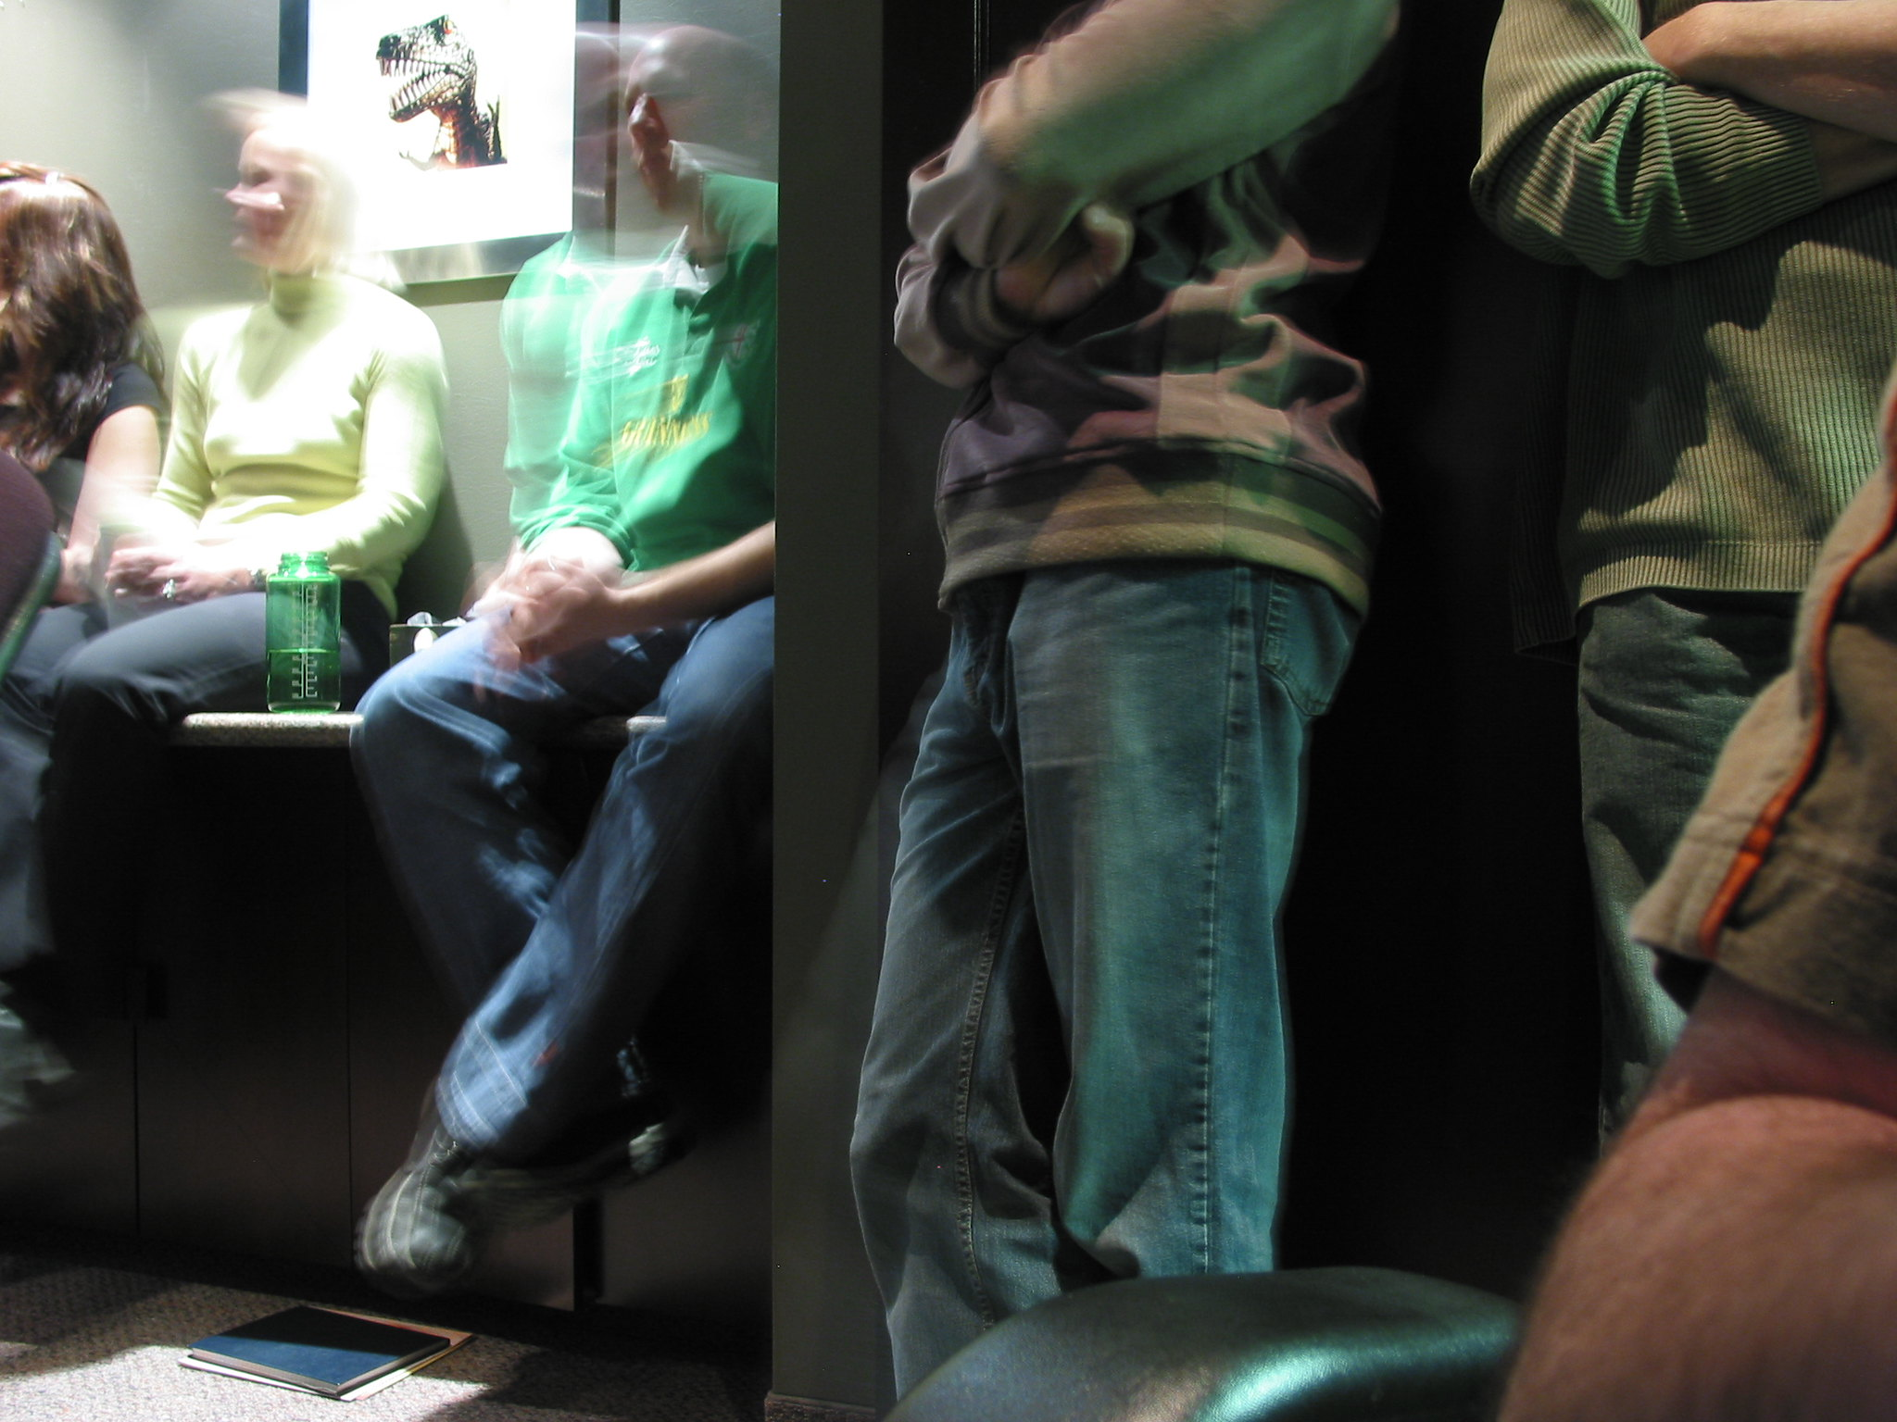
You get the small paper you wrote the credentials and you show them. The user id seems okay, but the password does not look like a password, rather than a blob of random data. You remember some of your readings that sometimes passwords are stored in hashes to prevent disclosure.
However, there are some great password crackers out there on the net. Find one and feed it with the hash you found. The people in the room are waiting for your results.
TASK: Crack the password hash.

Slide 12
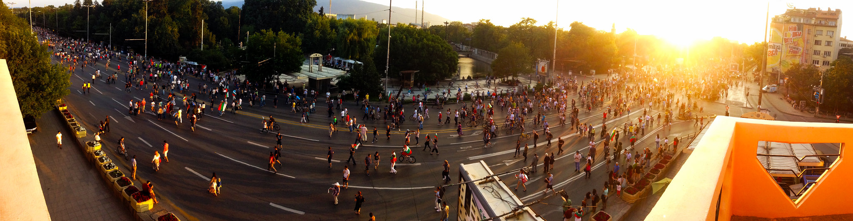
It worked! The user ID and the password was useful for authenticating successfully into several social media and emailing accounts of the big guy of the State Party and man, there was nasty stuff there including everything you can imagine about a man like this.
The connections of the Resistance at the media took care about the discolsure of these information from ‚unnamed source’ and it helped to wake up some of the people at Chernograd and also in the countryside to rise. At start for the impeachment of the government, but after for the complete reformation of the state to clean it from the systematical corruption.
The Resistance gave you back your freedom and the police will no longer harass you, they have significantly more important business to do. You are excited about the future and to see what could be the consequences of the acts you participated in.

Slide 13
Takeaway Box
Even when you did your best to secure a product by design, an insider threat can make your safeguards futile. Environmental security is as important as robust design.
Limiting the authentication attempts only by listening failed responses does not provide enough protection during the challenge&response mechanisms: it is necessary to look for the seed requests as well as authentication attempts – any unresponded seed shall be handled as a suspicious event.
A password shall only be stored in a secure form. See OWASP Cheat Sheet for Password Storage: https://cheatsheetseries.owasp.org/cheatsheets/Password_Storage_Cheat_Sheet.html
For more information on Exposure of Sensitive Information see https://cwe.mitre.org/data/definitions/200.html

